Slide 1
Introduction to
Spring Cloud Config
S a m u e l C a r d o n i s

Slide 2
Agenda
What is Spring Cloud ?
What is Spring Cloud Config ?
Architecture
Configuration Hierarchy
Security
Implementation
Usage
Demo
QA

Slide 3
What is Spring cloud
Spring Boot based apps that provide integration with external spring boot apps or systems.
Spring Cloud provides tools for developers to quickly build some of the common patterns in distributed systems
(e.g. configuration management, control bus, service discovery(Eureka), circuit breakers(Hystrix), routing, micro-proxy)
Main Projects:
Spring Cloud Config : Centralized external configuration management backed by a git/svn/db repository.
The configuration resources map directly to Spring `Environment` but could be used by non-Spring applications if desired.
Spring Cloud Netflix : Integration with various Netflix OSS components (Eureka, Hystrix, Zuul, Archaius, etc.).
Spring Cloud Bus : An event bus for linking services and service instances together with distributed messaging.
Useful for propagating state changes across a cluster (e.g. config change events).
Spring Cloud for Cloud Foundry : Integrates your application with Pivotal Cloud Foundry.
Provides a service discovery implementation and also makes it easy to implement SSO and OAuth2 protected resources.
Spring Cloud Open Service Broker : Provides a starting point for building a service broker that implements the Open Service Broker API.
Spring Cloud Zookeeper : Service discovery and configuration management with Apache Zookeeper.
Spring Cloud for Amazon Web Services : Easy integration with hosted AWS.

Slide 4
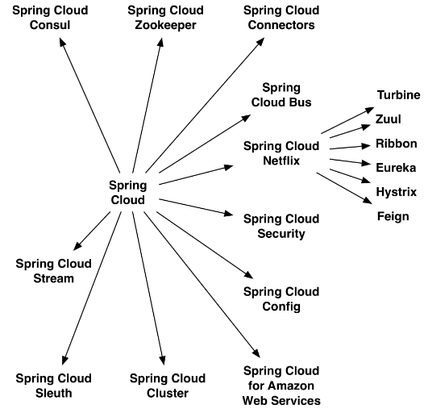
What is Spring cloud

Slide 5
What is Spring cloud config(open source centralized external configuration management)
Centralized and external- Good practice in distributed system
put all logs to 1 logging solution such as the ELK stack
put all monitoring to 1 dedicated monitoring solution
put all configuration files in 1 externalized and centralized configuration repository
Resilient
Spring cloud config should be run multiple instances behind a load balancer(preferably internal ELB)
To eliminate single point of failure
Allows Pull / Push configuration from multiple Repositories (or / and)
Jdbc / git / svn / File System / vault
Allows configuration change at run-time
curl -X POST set -u oo:S2Rod#2033a http://localhost:8081/refresh
Allows complex configuration Branching / Tagging / common
spring.cloud.config.server.svn.search-paths=repository/apps/{application}/{profile}[/{label}]
spring.cloud.config.allowsOverride=true
spring.cloud.config.overrideNone=true
Secured + allows encryption of sensitive data
spring.cloud.config.server.encrypt.enabled=true
management.security.enabled=true
security.user.password=S2Rod#2033a

Slide 6
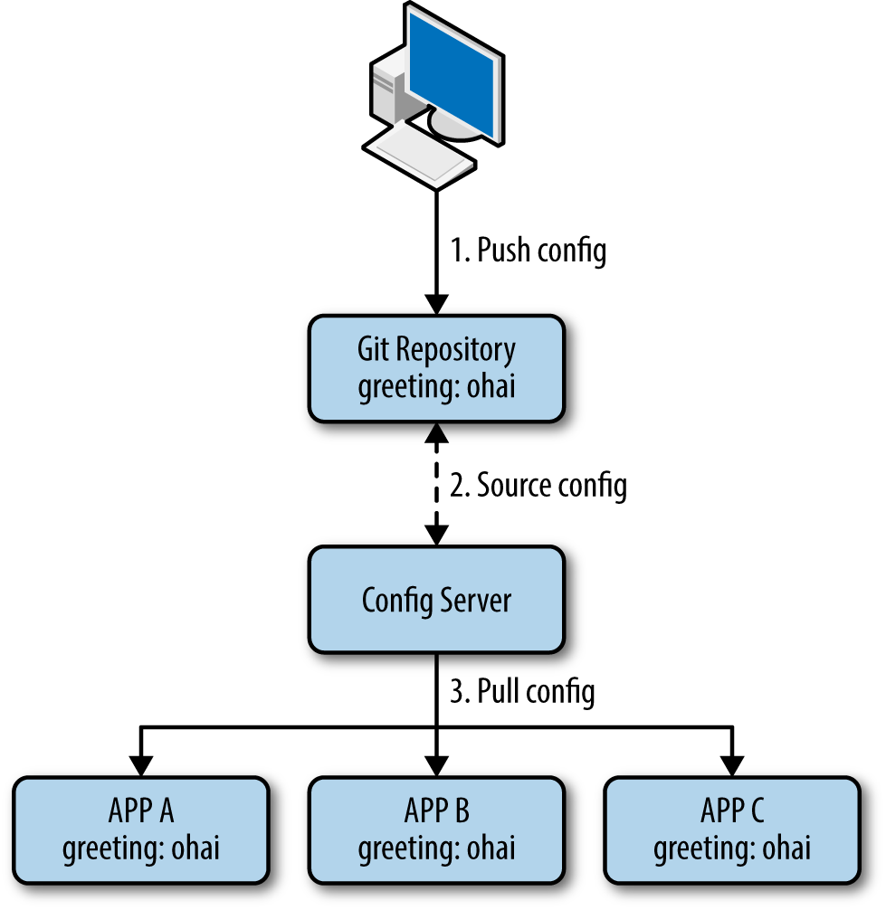
Architecture
Each app has it’s own configuration files.
Disadvantages of this approach:
downtime of the system on every changes to application’s configuration.
no traceability: how do we determine what changes were introduced into production and, if necessary, roll back?
configuration is de-centralized and it’s not immediately apparent where to go to change what.
not secured: sometimes configuration values should be encrypted and decrypted for security. There is no out-of-the-box support for this.
Each microservice has it’s own configuration files

Slide 7
Architecture
We added a config server
all clients will pull configuration from it
On every restart and on every post refresh command
server.port=9000
Each microservice has his own configuration files
Add bootstrap.properties
spring.cloud.config.enabled=true, spring.cloud.config.uri=localhost:9000

Slide 8
Architecture
We added a repository that store all configuration files
config server will pull files from it
We added a config server
all clients will pull configuration from it
On every restart and on every post refresh command
server.port=9000, spring.cloud.config.server.svn.uri=
Each microservice has his own configuration files
Add bootstrap.properties
spring.cloud.config.enabled=true, spring.cloud.config.uri=localhost:9000

Slide 9
Architecture
9000
8081 8082 8083
Devops
Devops can control and access
all components : repo, server, all clients
We added a repository that store all configuration files
config server will pull files from it
We added a config server
all clients will pull configuration from it
On every restart and on every post refresh command
server.port=9000, spring.cloud.config.server.svn.uri=
Each microservice has his own configuration files
Add bootstrap.properties
spring.cloud.config.enabled=true, spring.cloud.config.uri=localhost:9000

Slide 10
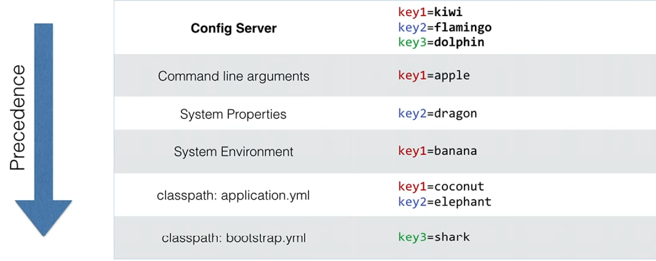
Configuration Hierarchy spring.cloud.config.allowsOverride=true, spring.cloud.config.overrideNone=false

Slide 11
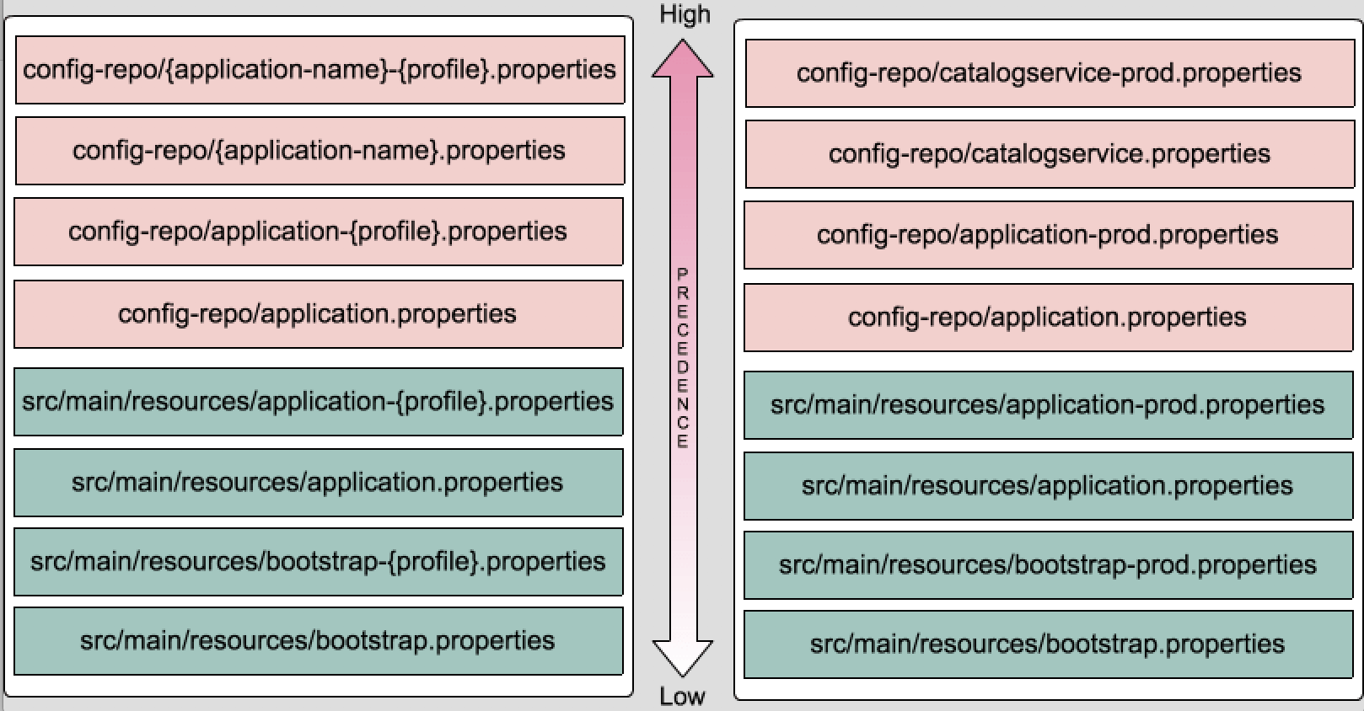
Configuration Hierarchy spring.cloud.config.allowsOverride=true, spring.cloud.config.overrideNone=false
Command line arguments / Java System properties(VM Options) / Operating System environment(Environment variables)

Slide 12
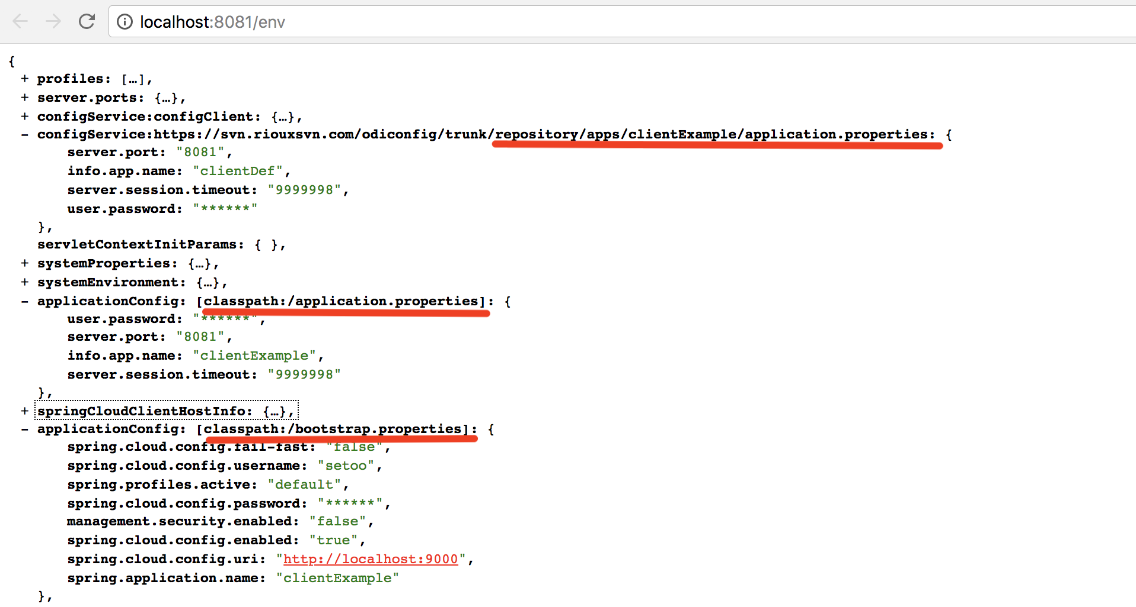
Configuration Hierarchy spring.cloud.config.allowsOverride=true, spring.cloud.config.overrideNone=false
Command line arguments / Java System properties(VM Options) / Operating System environment(Environment variables)

Slide 13
Security
Secure your Config server
security.user.name=setoo
security.user.password=S2Rod#2033a
Secure your Configuration Endpoint
management.security.enabled=true
encrypted / decrypted your Sensitive data
On client side
$ curl -X POST localhost:9000/encrypt -d mysecret
AgCQkUuYPXSHCtpEXn6D+/EhTFlVhy
$ curl -X POST localhost:9000/decrypt -d AgCQkUuYPXSHCtpEXn6D+/EhTFlVhy
Mysecret
user.password={cipher}AgCQkUuYPXSHCtpEXn6D+/EhTFlVhy
On server side
spring.cloud.config.server.encrypt.enabled=true

Slide 14
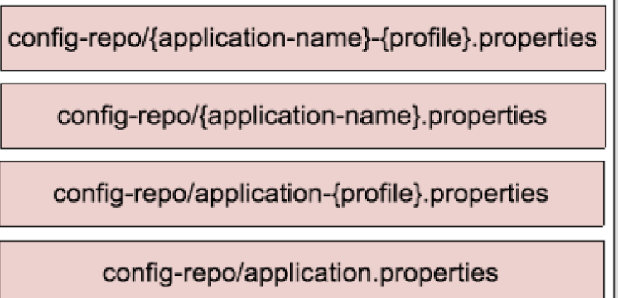
Implementation ( 1 / 3 )
Step 1 : Set Repository
1.1 Create git / svn / File System / vault Repository
1.2 Add configuration files to Repository :
$ mkdir repository
$ cd repository
$ git init .
$ echo info.foo: bar > application.properties
$ git add -A .
$ git commit -m "Add application.properties"
{app name} - {profile} . [ properties / yml ]

Slide 15
Implementation ( 2 / 3 )
Step 2 : Set Config server
2.1 Create a Spring Boot Project with 2 dependencies :
actuator, spring-cloud-config-server
2.2 Add to mainApp.java annotations
@SpringBootApplication , @EnableConfigServer
2.3 Set application.properties
server.port=9000, spring.cloud.config.server.svn.uri=...
2.4 Start service
Configuration is pulled automatically...

Slide 16
Implementation ( 3 / 3 )
Step 3 : Set Each client
3.1 Create a Spring Boot Project with 2 dependencies
actuator, spring-cloud-config-client
3.2 Add to mainApp.java annotations
@SpringBootApplication
3.3 Set bootstrap.properties
spring.cloud.config.enabled=true, spring.cloud.config.uri...
3.3 Add @RefreshScope annotation on each
@Bean / @Controller / @Component / @Configuration
3.4 start client - Configuration is pulled automatically...

Slide 17
Usage via http/curl/postman (server side)
curl -X GET localhost:9000/env (sorted by precedence)
curl -X GET localhost:9000/env/info.app.name
curl -X POST localhost:9000/encrypt -d mysecret
curl -X POST localhost:9000/decrypt -d encryptedText
curl -X GET <host>:<serverPort>/<appName>-<profile>.properties
curl -X GET localhost:9000/batch-dev.properties or http://localhost:9000/batch/dev
curl -X GET localhost:9000/batch-default.properties or http://localhost:9000/batch/default
curl -X GET localhost:9000/main-dev.properties or http://localhost:9000/main/dev
curl -X GET localhost:9000/main-default.properties or http://localhost:9000/main/default

Slide 18
Usage via http/curl/postman (on each client)
curl -X GET localhost:8081/env (sorted by precedence)
curl -X GET localhost:8081/env/info.app.name
curl -X GET localhost:8081/health
curl -X GET localhost:8081/<someController>
curl -X POST localhost:8081/env -d info.app.name=newValue
curl -X GET localhost:8081/<someController>
curl -X POST localhost:8081/refresh
curl -X GET localhost:8081/<someController>

Slide 19
Demo...

Slide 20
QA...

Slide 21
TODOs:
Change the port from 8081 to something else.
Make a local bootstrap.config file that will set the cloud config to false.

